Slide 1
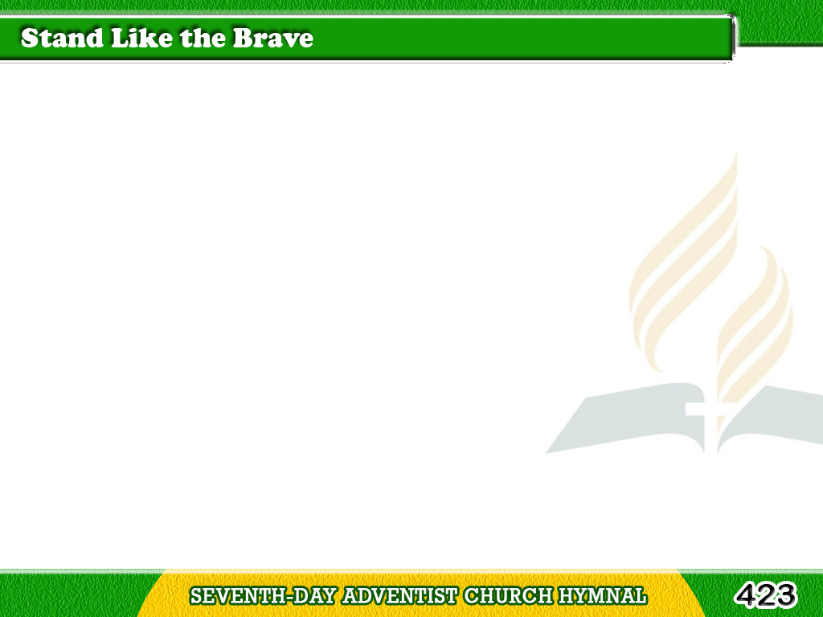
1/3
O Christian, awake!
‘tis the Master’s command;
With helmet and shield,
and a sword in thy hand,
Tagalog
Version

Slide 2
1/3
To meet the bold tempter,
go, fearlessly go,
Then stand like the brave,
with thy face to the foe.
Tagalog
Version

Slide 3
1/3
Stand like the brave,
stand like the brave,
Stand like the brave,
with thy face to the foe.
Tagalog
Version

Slide 4
2/3
The cause of thy Master
with vigor defend;
Be watchful, be zealous,
and fight to the end;
Tagalog
Version

Slide 5
2/3
Wherever He leads thee,
go, valiantly go,
Then stand like the brave,
with thy face to the foe.
Tagalog
Version

Slide 6
2/3
Stand like the brave,
stand like the brave,
Stand like the brave,
with thy face to the foe.
Tagalog
Version

Slide 7
3/3
Press on, never doubting,
thy Captain is near,
With grace to supply,
and with comfort to cheer;
Tagalog
Version

Slide 8
3/3
His love, like a stream
in the desert will flow;
Then stand like the brave,
with thy face to the foe.
Tagalog
Version

Slide 9
3/3
Stand like the brave,
stand like the brave,
Stand like the brave,
with thy face to the foe.
Tagalog
Version

